Slide 1


Tracking
Motivation: Req. 1.2.1: The system shall identify human targets within 5 meters
Req. 2: The system shall track visually identified targets
Notes:
----- Meeting Notes (10/14/15 11:42) -----

Slide 2
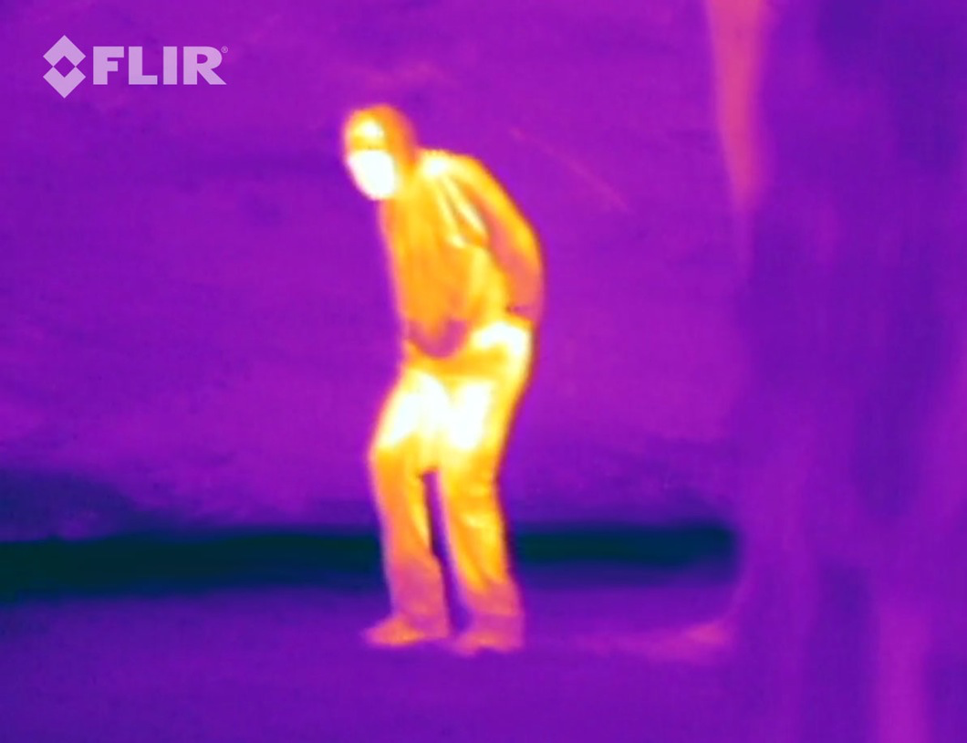
Tracking Method
Must process images at >= 5 Hz (Req. 2.2.1)
Use C++ and OpenCV for low-overhead image processing
OpenCV has significant documentation and many useful libraries
OpenCV used in conjunction with Multiple Hypothesis Tracking (MHT) and Kalman Filtering will provide quick and accurate tracking solutions
Preliminary Sensor: Lepton 80x60 Pixel LWIR camera
Provides contrast between human and background
<50 mK sensitivity
Notes:
----- Meeting Notes (10/14/15 11:42) -----
Export controlled version is only 9Hz
Change req to 5Hz
Temp range of FLiR
Dynamic Ranging?
Screenshot sparkfun video
Body movement

Slide 3
Algorithm Overview
Obtain Object Measurements
Generate Hypotheses
Prune Hypotheses
Correlate Hypotheses with Previous Feasible Tracks
Prune Feasible Tracks
Publish Confirmed Tracks

Slide 4
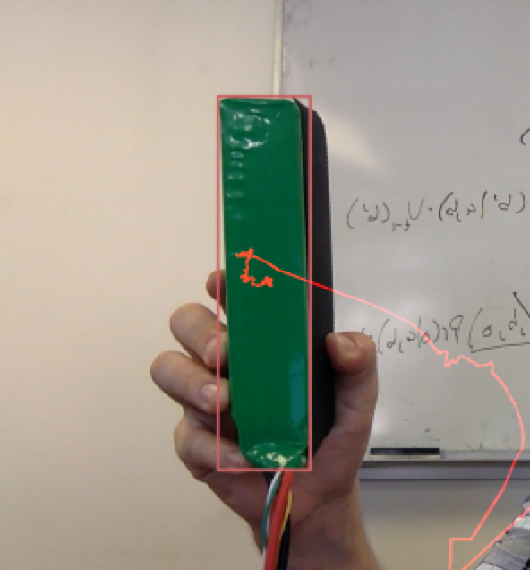
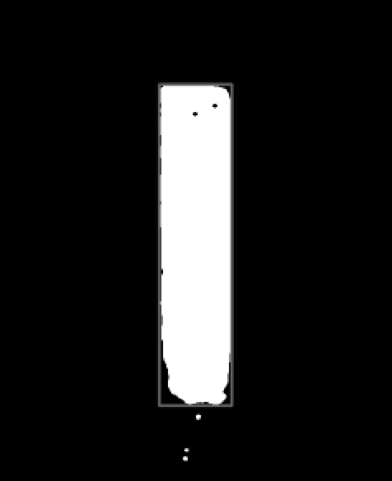
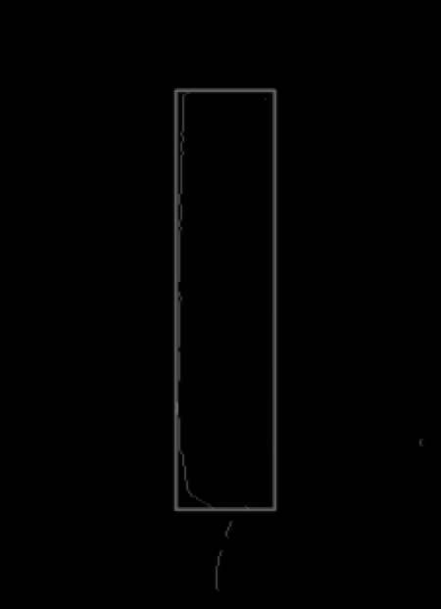
Obtaining Measurements from Images
Obtain Image
Mask Image
Find Contours
Save Features
Features:
Area
X Position
Y Position
Computed Features:
Δ Area
X Velocity
Y Velocity

Slide 5
Algorithm Overview
Obtain Object Measurements
Generate Hypotheses
Prune Hypotheses
Correlate Hypotheses with Previous Feasible Tracks
Prune Feasible Tracks
Publish Confirmed Tracks

Slide 6
Generating Hypotheses
Objects of interest are detected at t0
t0

Slide 7
Generating Hypotheses
New objects of interest are detected at t1 and they can be associated to form feasible tracks
t1

Slide 8
Generating Hypotheses
New objects of interest are detected at t1 and they can be associated to form feasible tracks
t1

Slide 9
Algorithm Overview
Obtain Object Measurements
Generate Hypotheses
Prune Hypotheses
Correlate Hypotheses with Previous Feasible Tracks
Prune Feasible Tracks
Publish Confirmed Tracks

Slide 10
Pruning Hypotheses
These may be down selected using a velocity constraint
t1

Slide 11
Pruning Hypotheses
This velocity constraint is used as follows:
t1

Slide 12
Pruning Hypotheses
Propagate the measurement’s state for one period:
t1
State Transition Matrix:

Slide 13
Pruning Hypotheses
Apply an error bound:
t1

Slide 14
Pruning Hypotheses
Prune hypotheses down to those that fit within velocity constraint
t1
Mahalanobis distance can be used to score possible matches:
Notes:
----- Meeting Notes (10/14/15 11:42) -----
Mahalanobis distance equation

Slide 15
Algorithm Overview
Obtain Object Measurements
Generate Hypotheses
Prune Hypotheses
Correlate Hypotheses with Previous Feasible Tracks
Prune Feasible Tracks
Publish Confirmed Tracks

Slide 16
Prune Feasible Tracks
Continue to form feasible tracks until tracks become improbable
t2

Slide 17
Algorithm Overview
Obtain Object Measurements
Generate Hypotheses
Prune Hypotheses
Correlate Hypotheses with Previous Feasible Tracks
Prune Feasible Tracks
Publish Confirmed Tracks

Slide 18
Prune Feasible Tracks
Track is terminated after no new correlated objects
t3
Notes:
----- Meeting Notes (10/14/15 11:42) -----
Better colors

Slide 19
State Transition Matrix
A State Transition Matrix (STM) can be used to further constrain the location of future object measurements
Notes:
----- Meeting Notes (10/14/15 11:42) -----
Put in state prop slide

Slide 20
Kalman Filtering
Notes:
----- Meeting Notes (10/14/15 11:42) -----
Characterize flir

